Slide 1


Online Testing

Slide 2
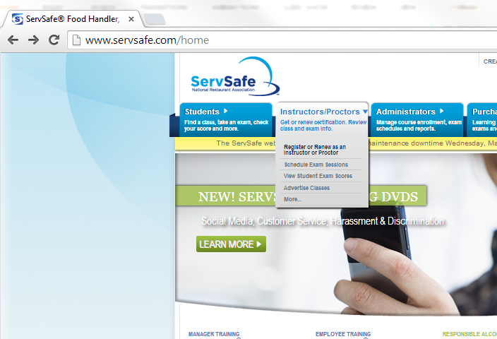
Registering to become a ServSafe Online Proctor
Open an internet browser and go to ServSafe.com
Click on Instructors/Proctors, then Register or Renew

Slide 3
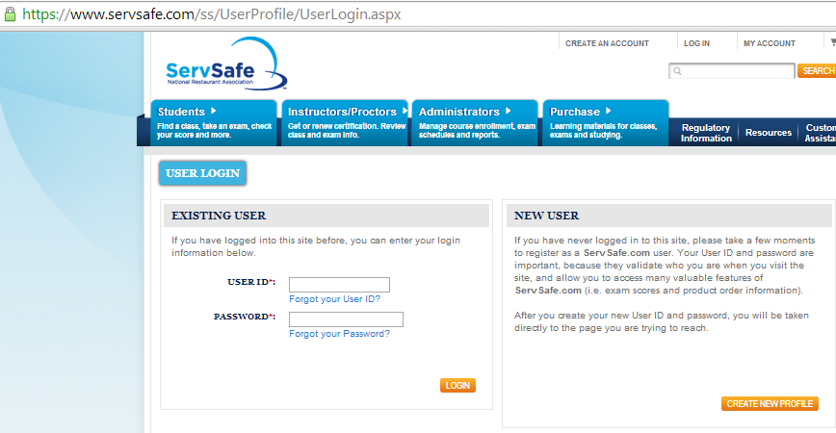
Under New User
Click on Create New Profile

Slide 4
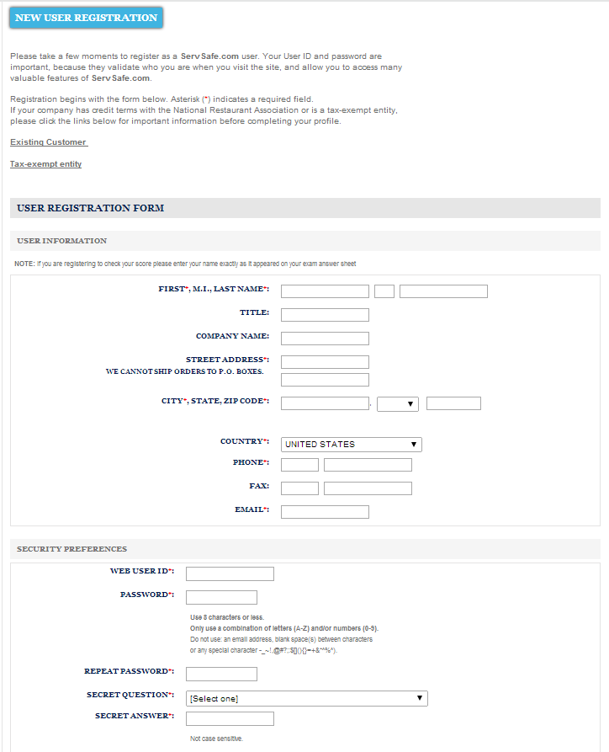
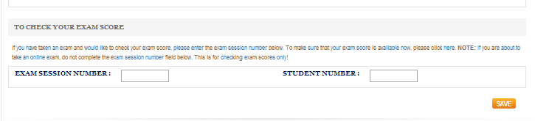
Under New User Registration
Complete the User Information
Then click Save

Slide 5
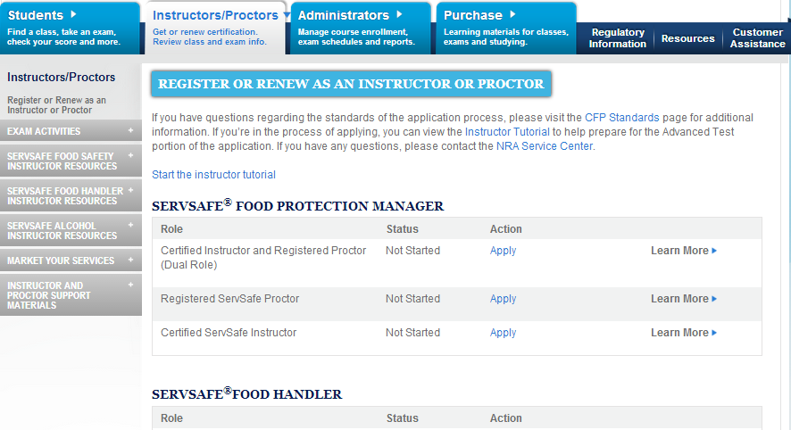
Under ServSafe Food Protection Manager
Registered ServSafe Proctor click Apply

Slide 6
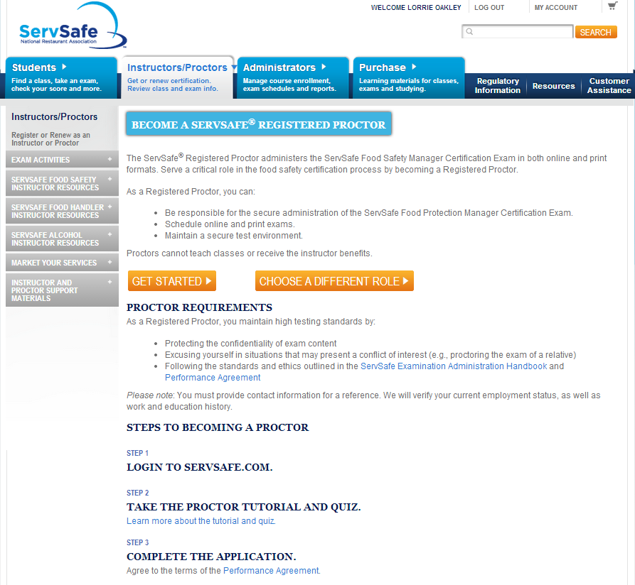
Under Become A ServSafe Registered Proctor
Notice there are three (3) steps
to complete
Click Get Started

Slide 7
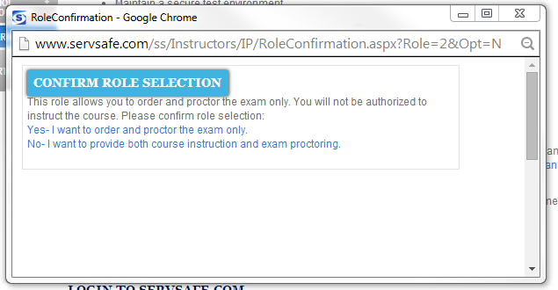
Popup Confirm Role Selection
Click Yes, unless you are also an instructor/trainer/teacher

Slide 8
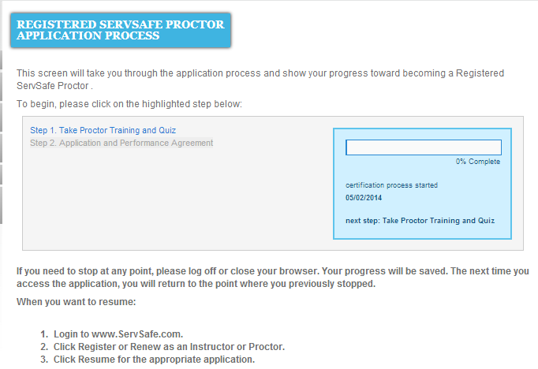
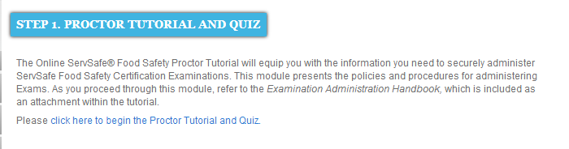
Popup Confirm Role Selection, Click Step 1
Then click to begin the Proctor Tutorial and Quiz

Slide 9
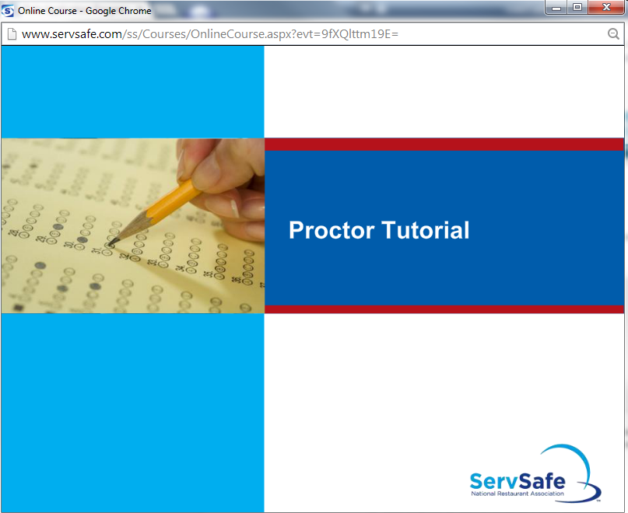
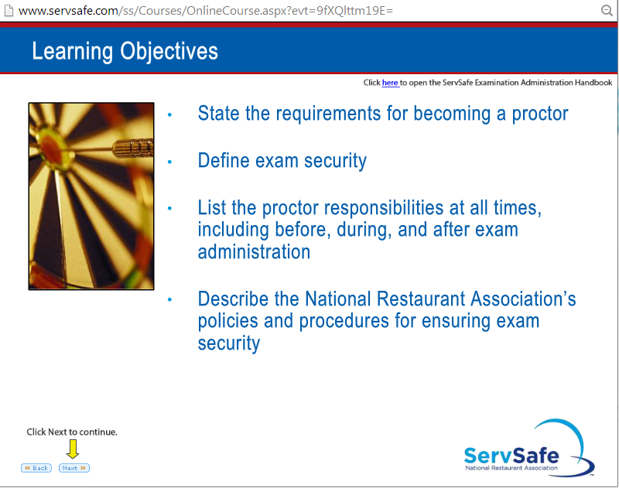
Start the online Tutorial
You will need to click next
to proceed to the next screen.

Slide 10
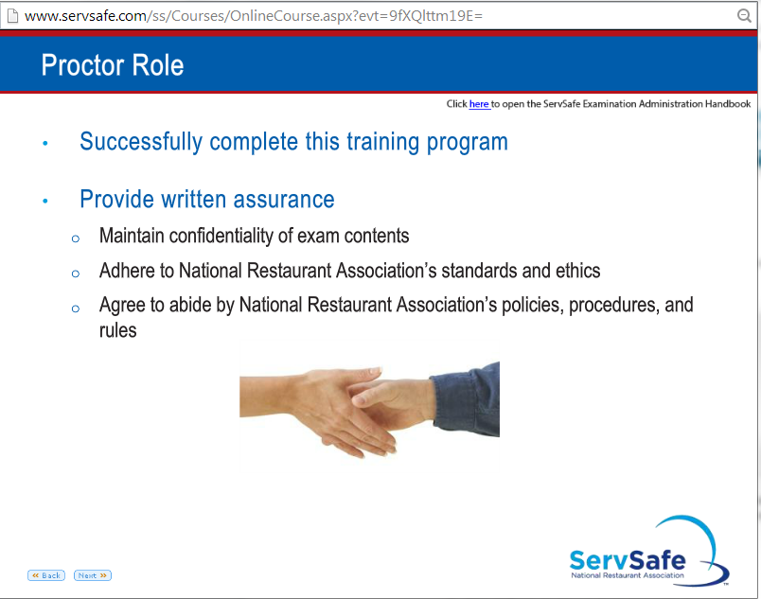
Click in the top right corner to access the
ServSafe Exam Administration Handbook
at any time

Slide 11
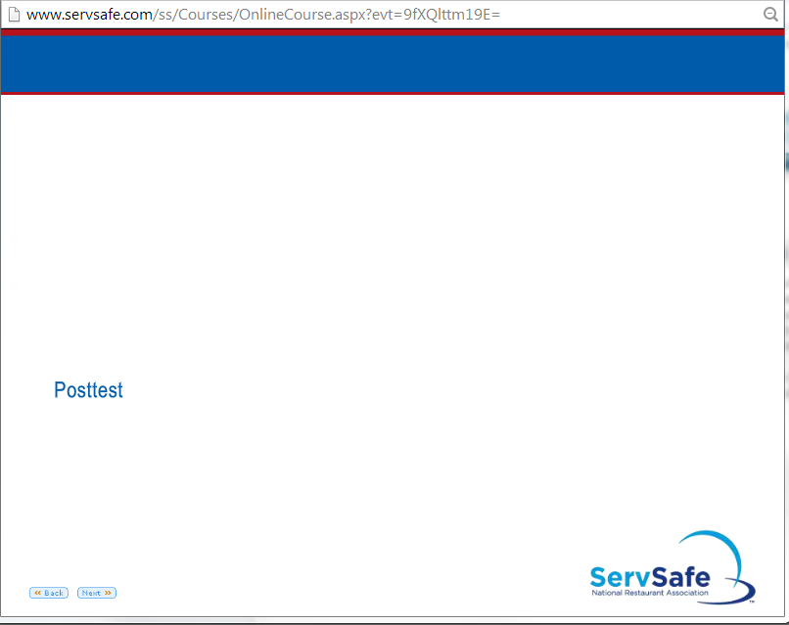
Complete the Post Test

Slide 12
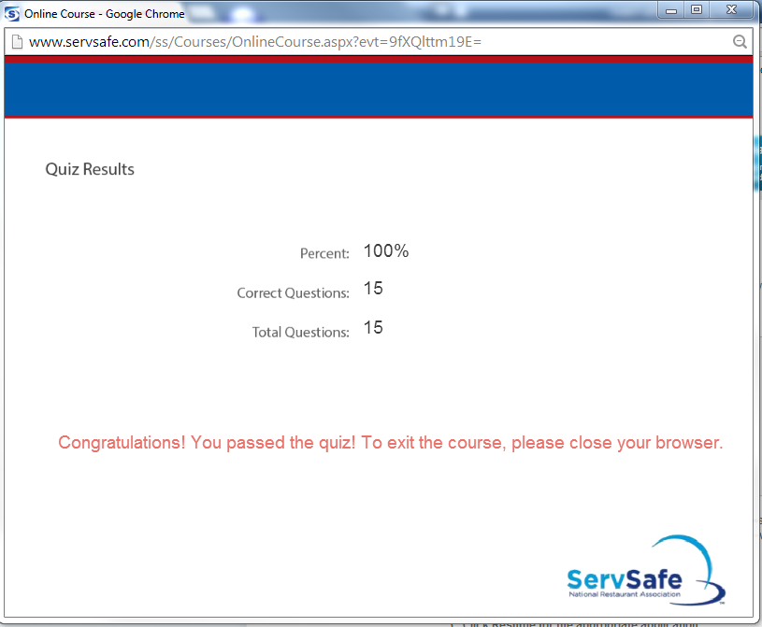
You must pass the Post Test. Retesting is acceptable if necessary. When finished, close the window.

Slide 13
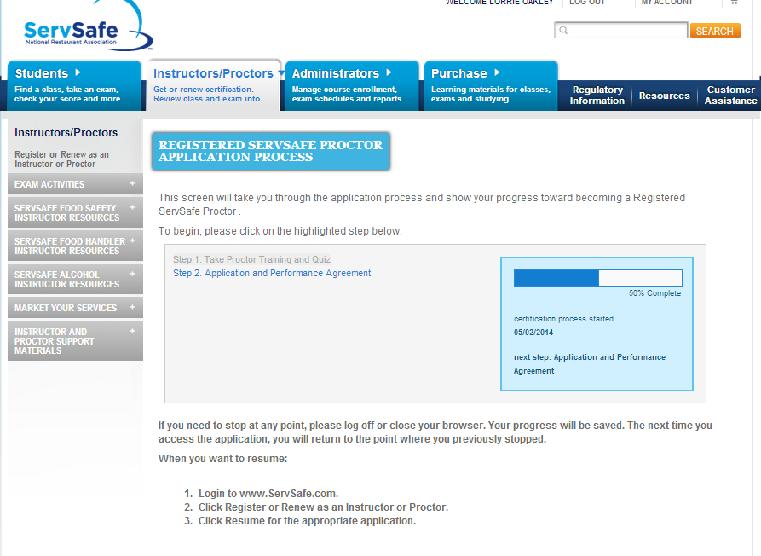
Complete Step 2

Slide 14
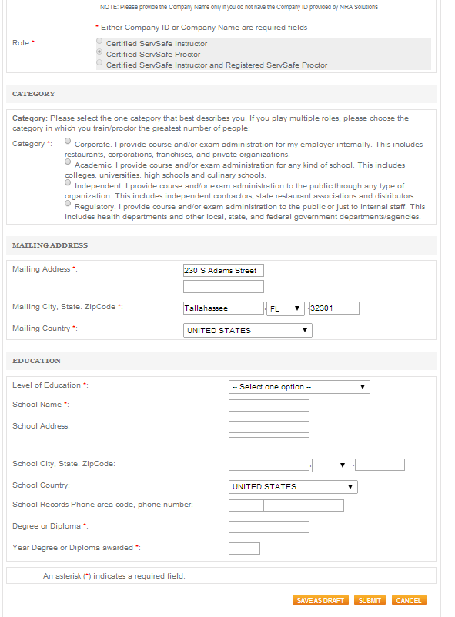
Be sure the appropriate Role is selected.
Select Academic.
Complete Education.
Click Submit.

Slide 15
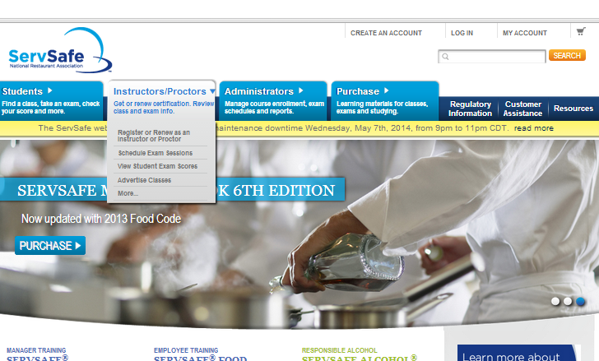
Scheduling a ServSafe Online Exam
Open an internet browser and go to ServSafe.com
Click on Instructor/Proctor, then Schedule Exam Sessions

Slide 16
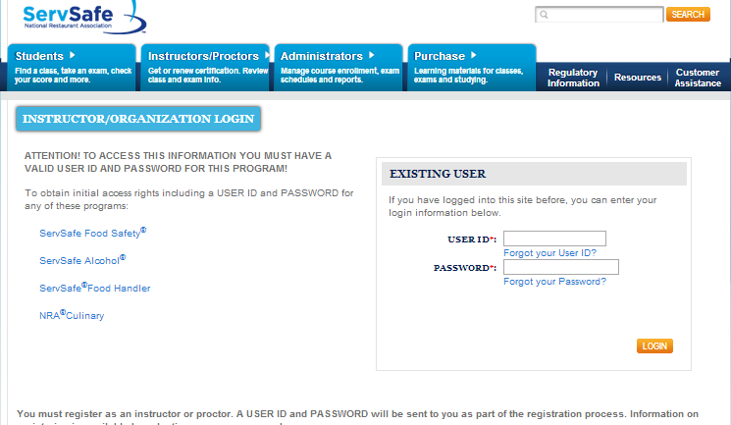
Proctors must log in to schedule an online exam

Slide 17
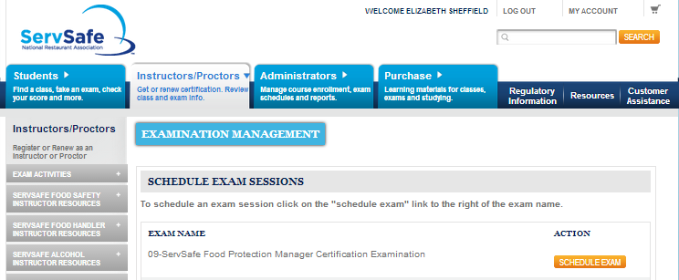
Choose which online exam program to administer

Slide 18
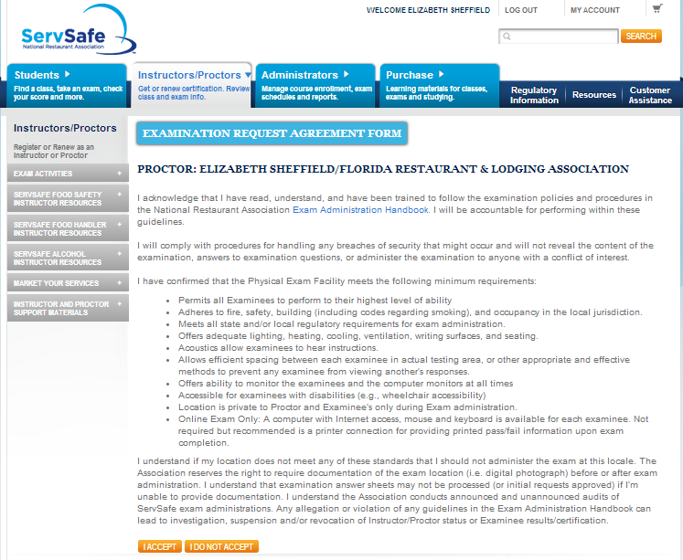
Agree to exam requirements.

Slide 19
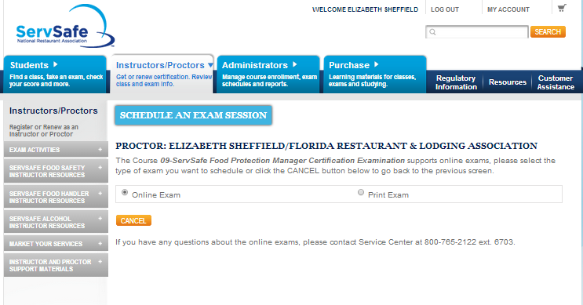
Choose the online exam version.

Slide 20
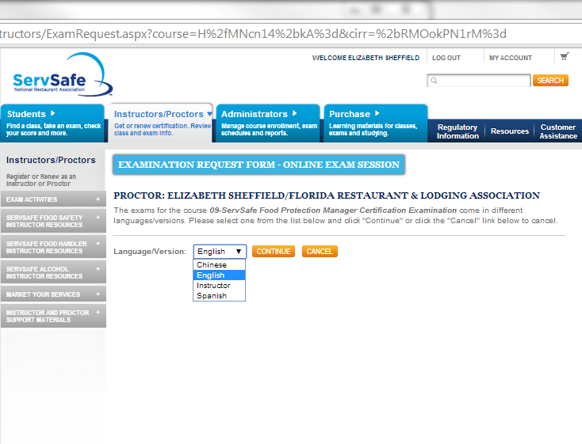
Choose an exam language for the student.

Slide 21
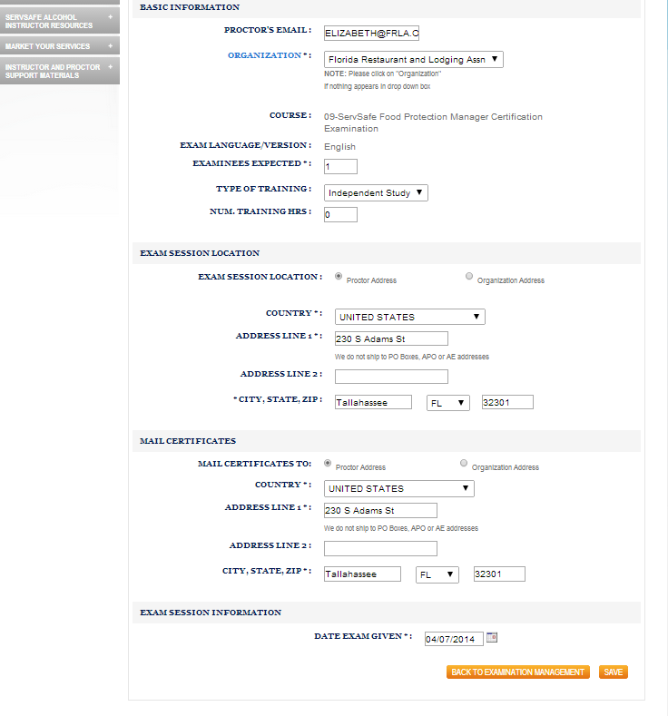
Request certificates be mailed to
Appropriate address

Slide 22
Schedule date for online exam.

Slide 23
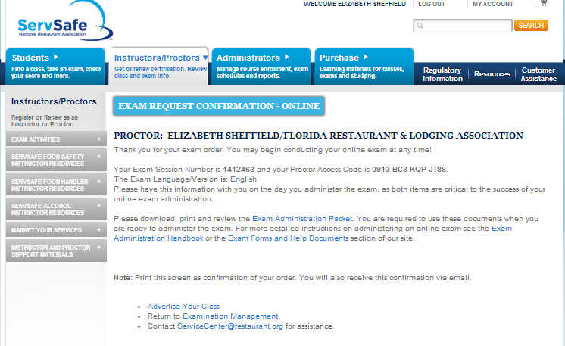
Print/ retain the online Proctor Access Code for this exam.

Slide 24
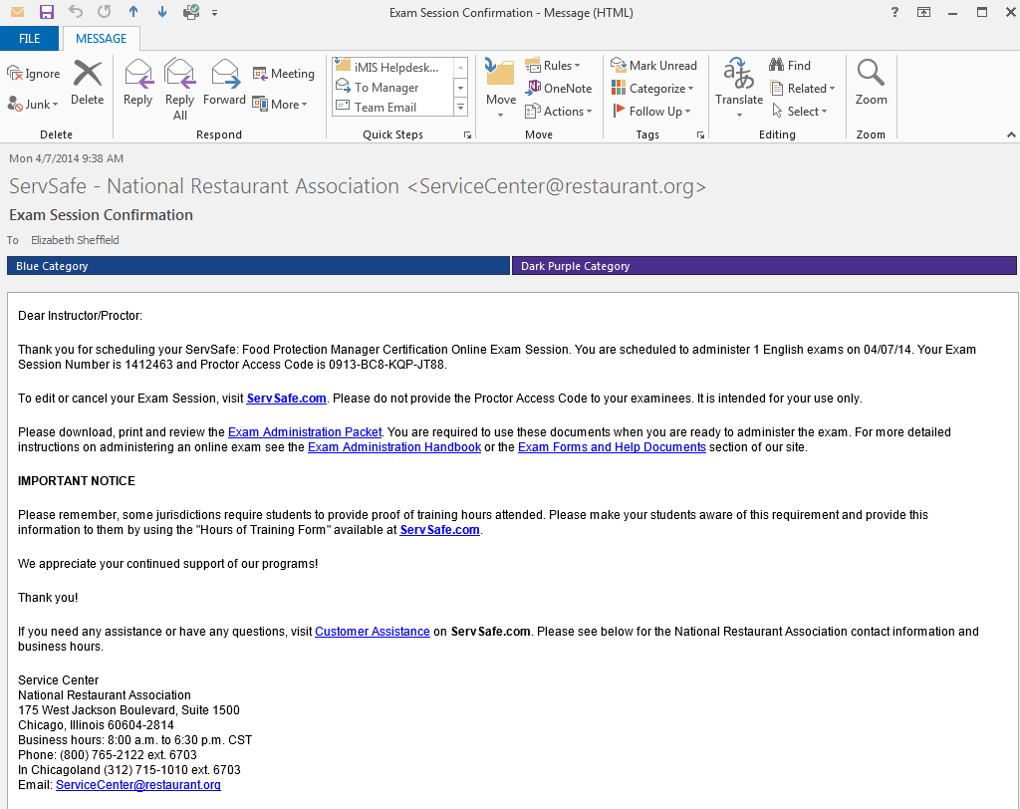
You will receive a confirmation via Email with the online Proctor Access Code for this exam.

Slide 25


Time to Test
Do you have:
  Your Proctor Number
  The Exam Session Scheduled
  The “Proctor Access Code”
Does the student have:
  ID
  Online Exam Voucher Code

Slide 26
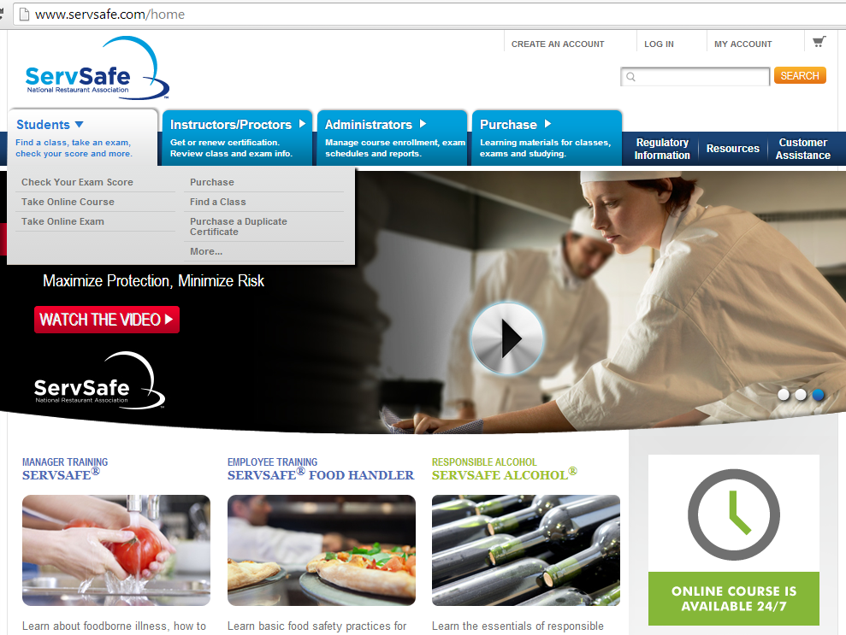

Slide 27
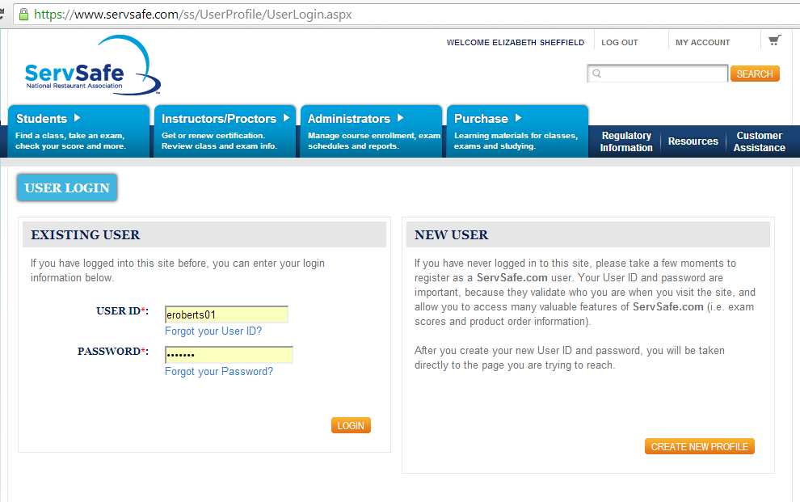
Students will be advised to go online prior to their exam date and create their ServSafe account.

Slide 28
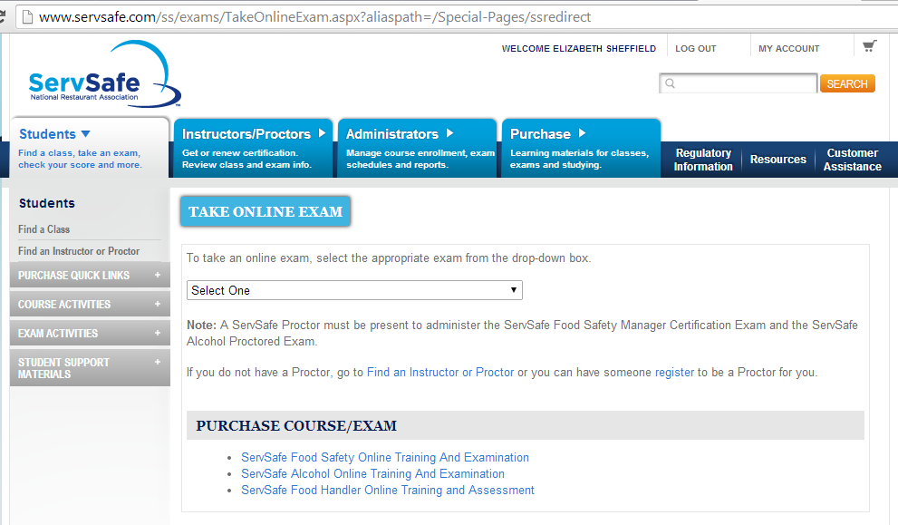

Slide 29
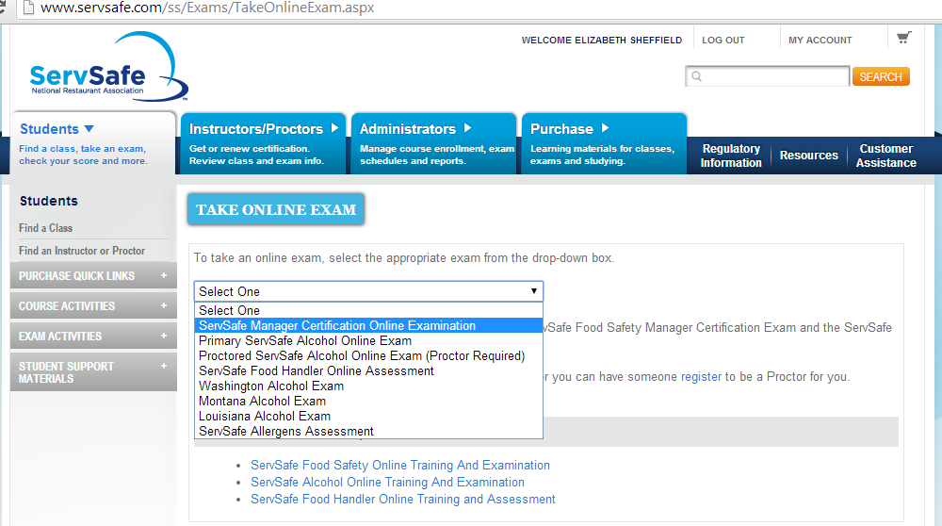

Slide 30
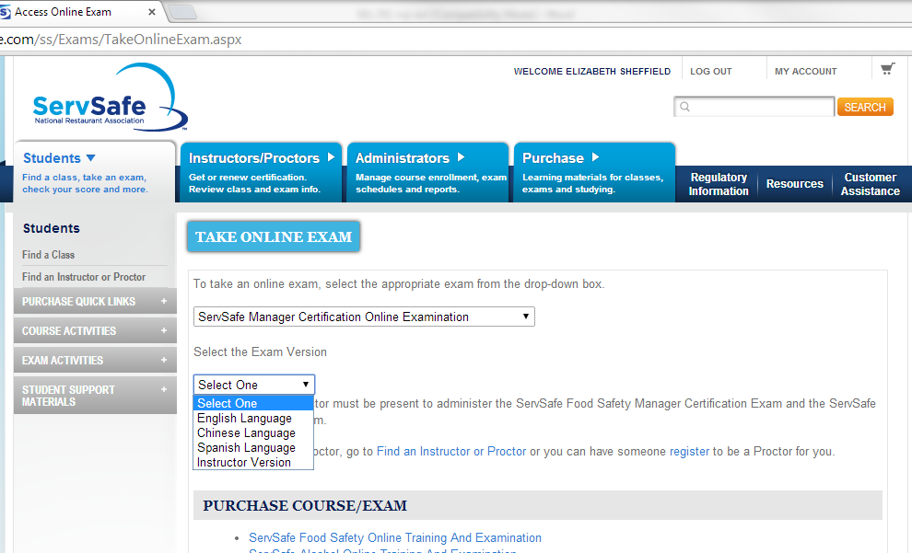

Slide 31
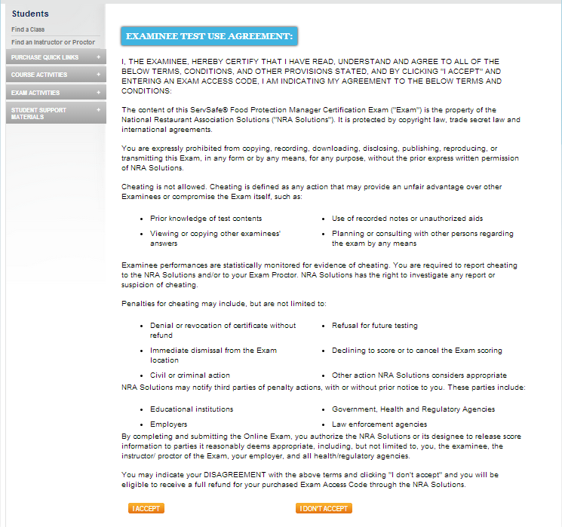

Slide 32
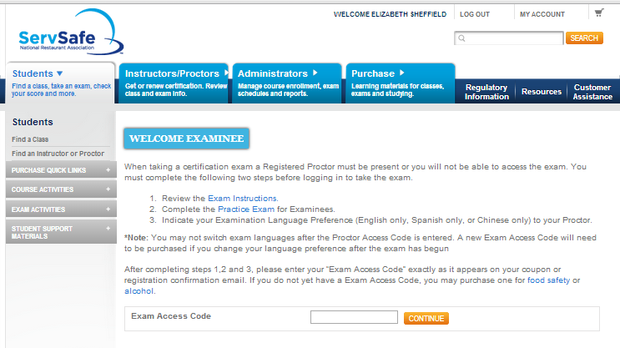
Must complete the following two steps

Slide 33
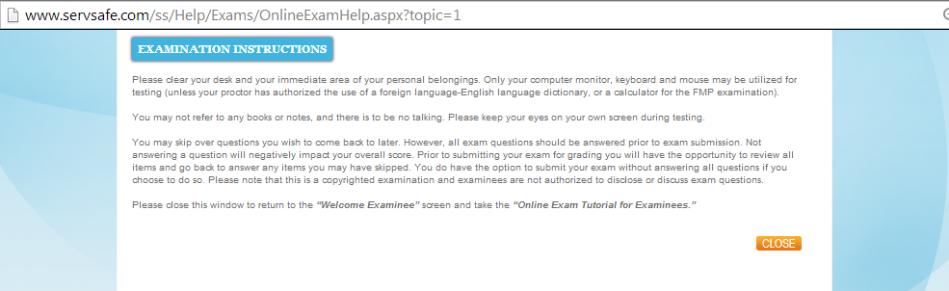

Slide 34
Must complete the following two steps

Slide 35
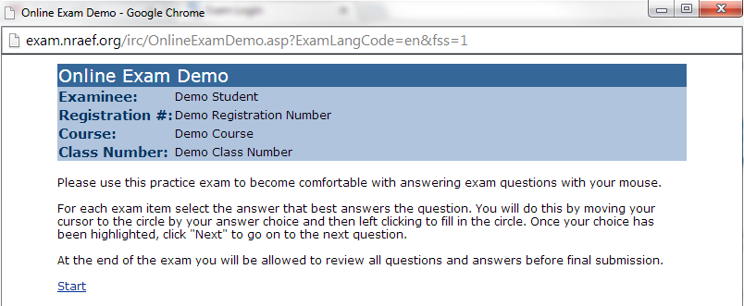
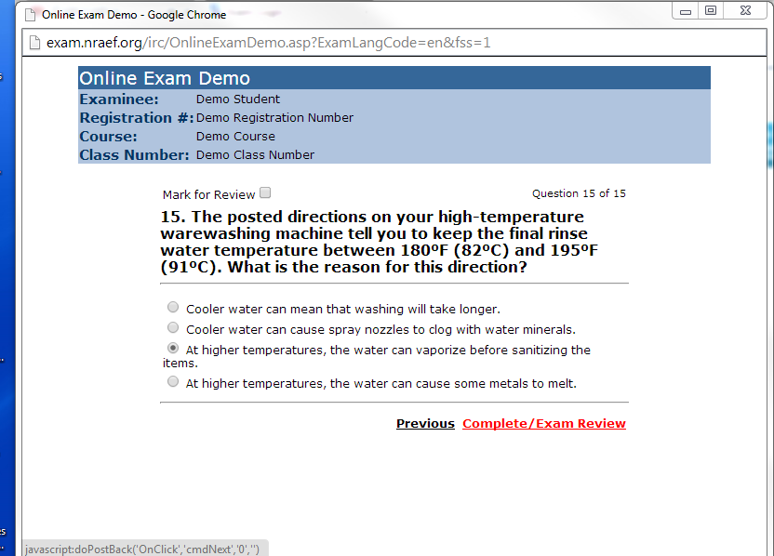

Slide 36
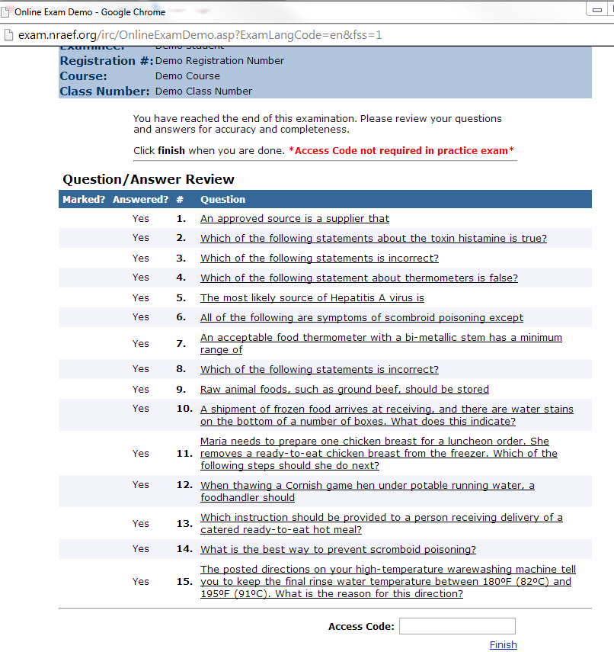

Slide 37
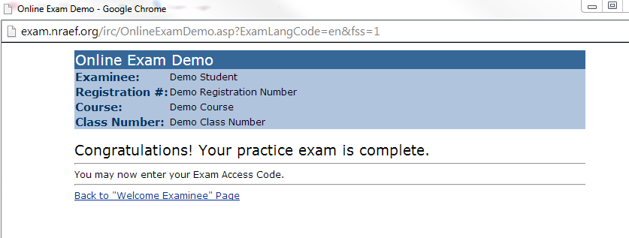

Slide 38
Student enters their Exam Access Code or Exam Voucher Code

Slide 39
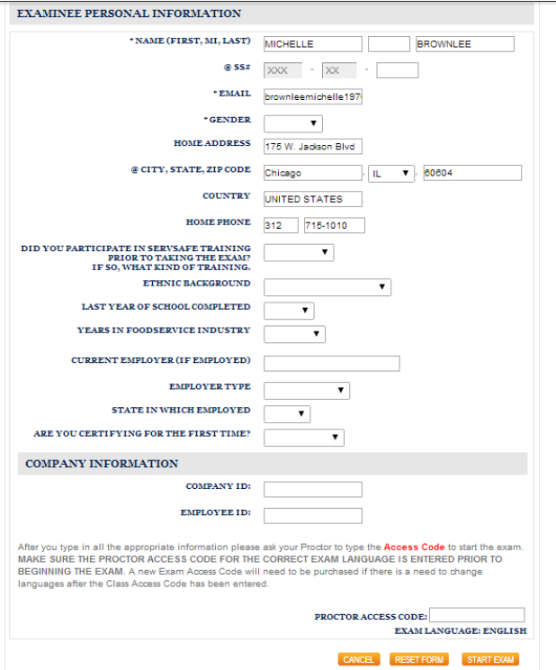
Student verifies the Examinee Personal Information
(this is exactly how their name will appear on their certificate.)
Student enters optional Demographic Information.
Proctor enters Proctor Access Code
and clicks Start Exam

Slide 40
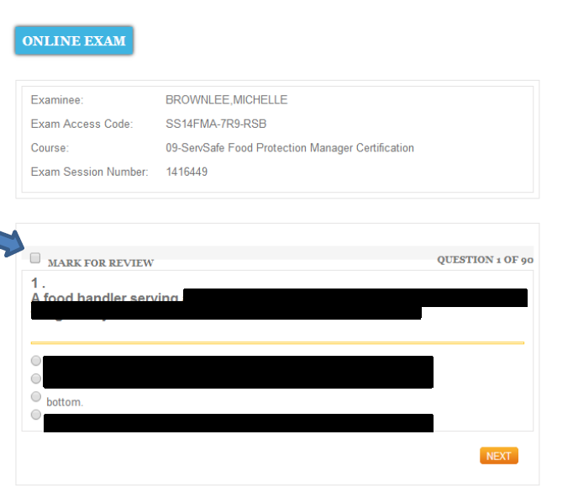
The exam is not auto-timed.
The Proctor must monitor the time, and
stop the exam after 2 hours.

Slide 41
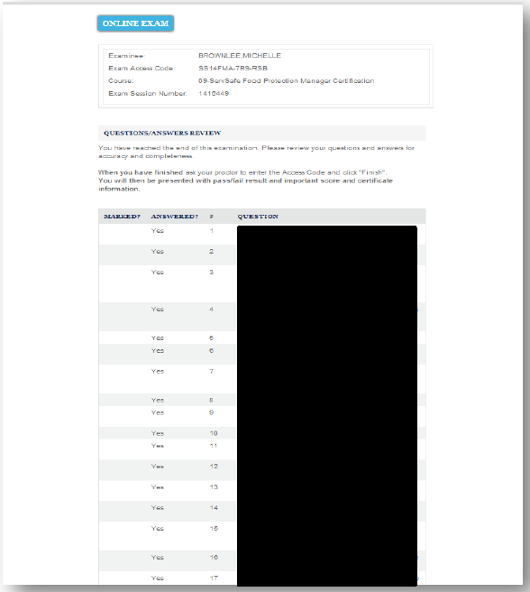
When the two (2) hours is up, or the student finishes their review, re-enter the Proctor Access Code and close the exam.

Slide 42
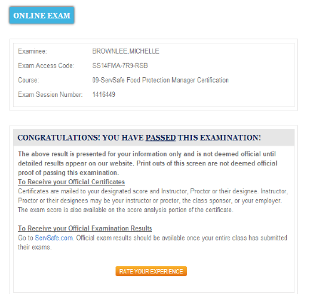
A
Pass/Fail
Message
will display for the student.
They may print a copy for their records.

Slide 43
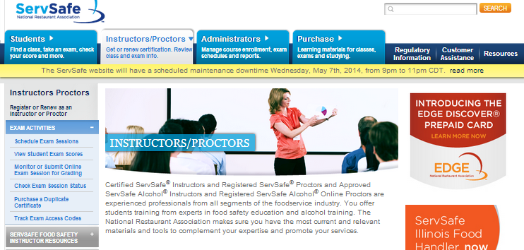
Proctors must log in to grade the online exam
Click Monitor or Submit Online Exam Session for Grading

Slide 44
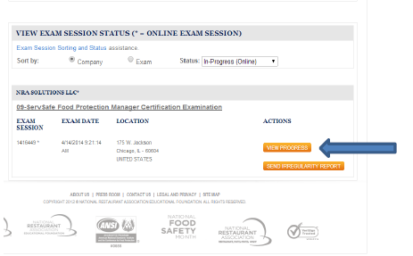
Under View Exam Session Status click View Progress

Slide 45
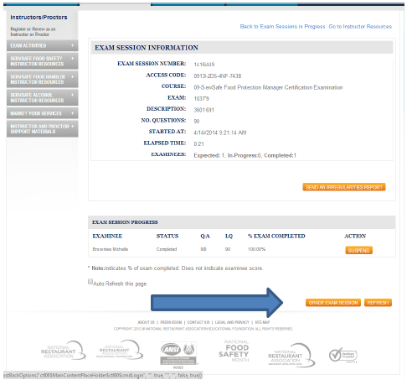
Under Exam Session Information
Click Grade Exam Session

Slide 46
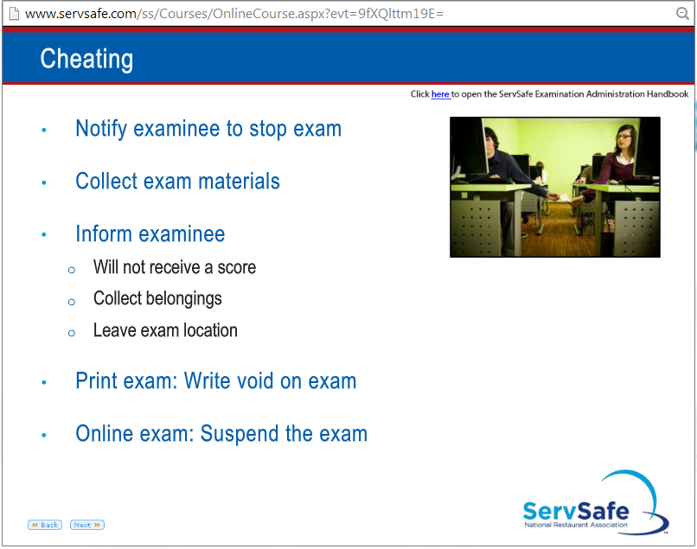
Cheating

Slide 47
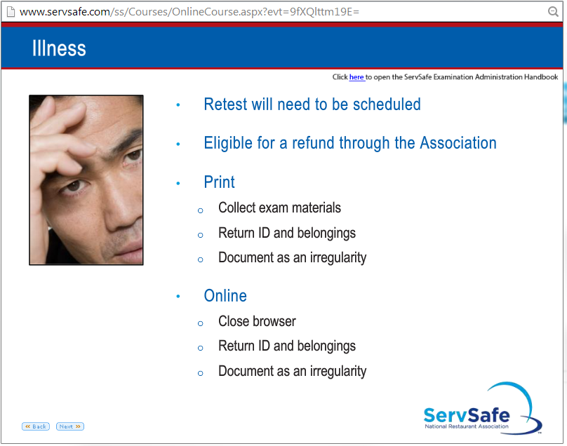
Illness

Slide 48
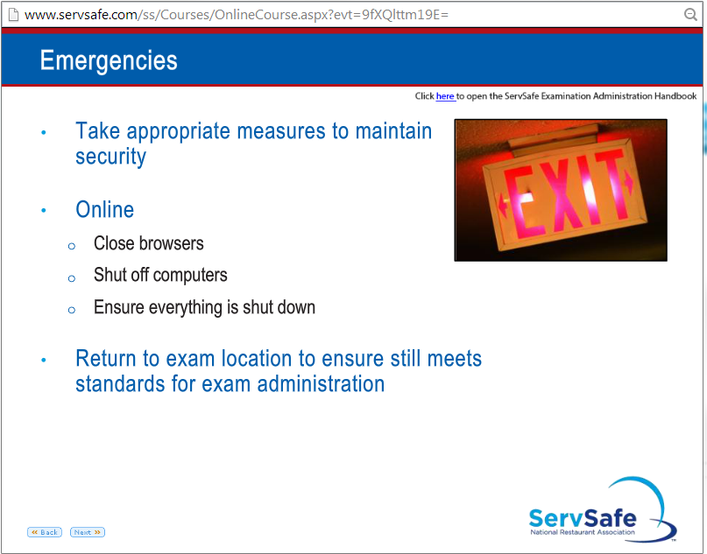
Emergencies

Slide 49
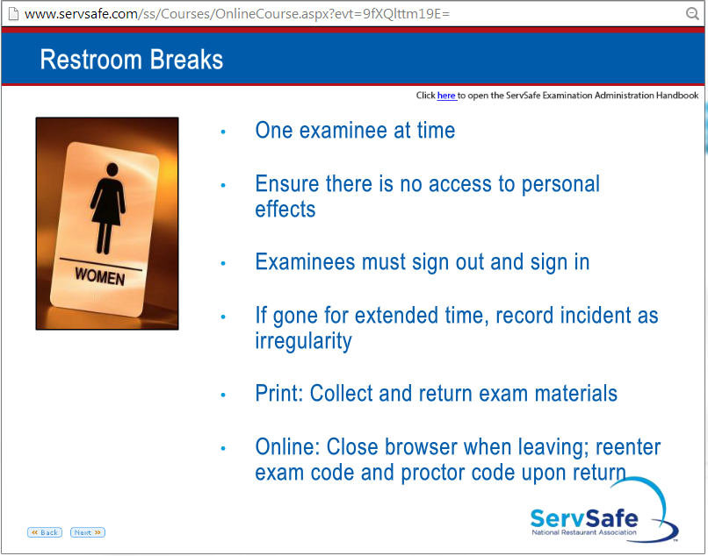
Restroom Break

Slide 50
Contact Information
Elizabeth Sheffield
Florida Restaurant and Lodging Association
(850) 224-2250 x236
elizabeth@frla.org

