Slide 1



@ProStart
/ProStartProgram
ChooseRestaurants.org
FRLA.org/educational-foundation/
/ProStartProgram
/GoProStart

Slide 2
The New COA Process Effective Fall 2014

Slide 3
The New Process: What Changed?
Changes:
Increased Capacity
Better, trackable Data
Streamlined process
What Doesn’t Change:
Requirements
Pass both exams
Document 400 hours
Complete Work Experience Checklist
Exams
Paper and Online Acceptable
Timeline
Scores are valid for 3 years
Notes:
The new online COA system replaces the former paper-and-pen system. COAs can no longer be processed manually.

Slide 4
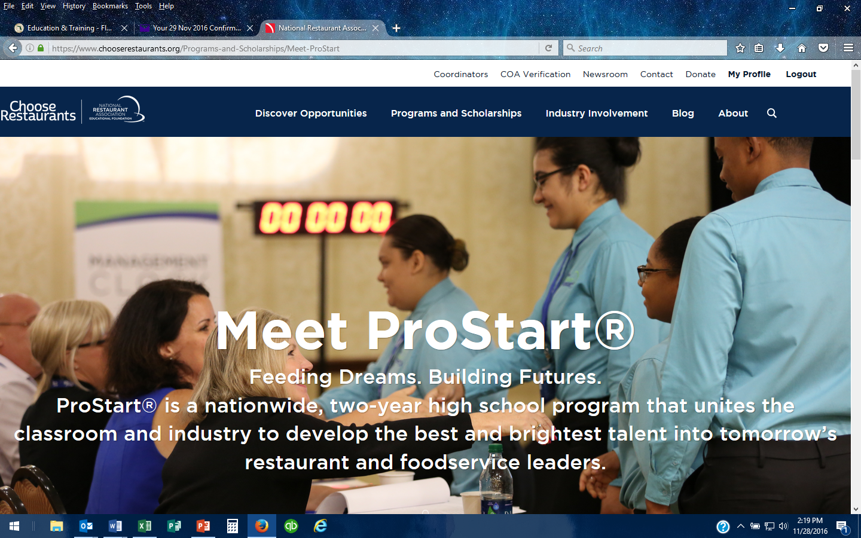
Notes:
Students have more responsibility for meeting the COA requirements under the new online system.

Slide 5
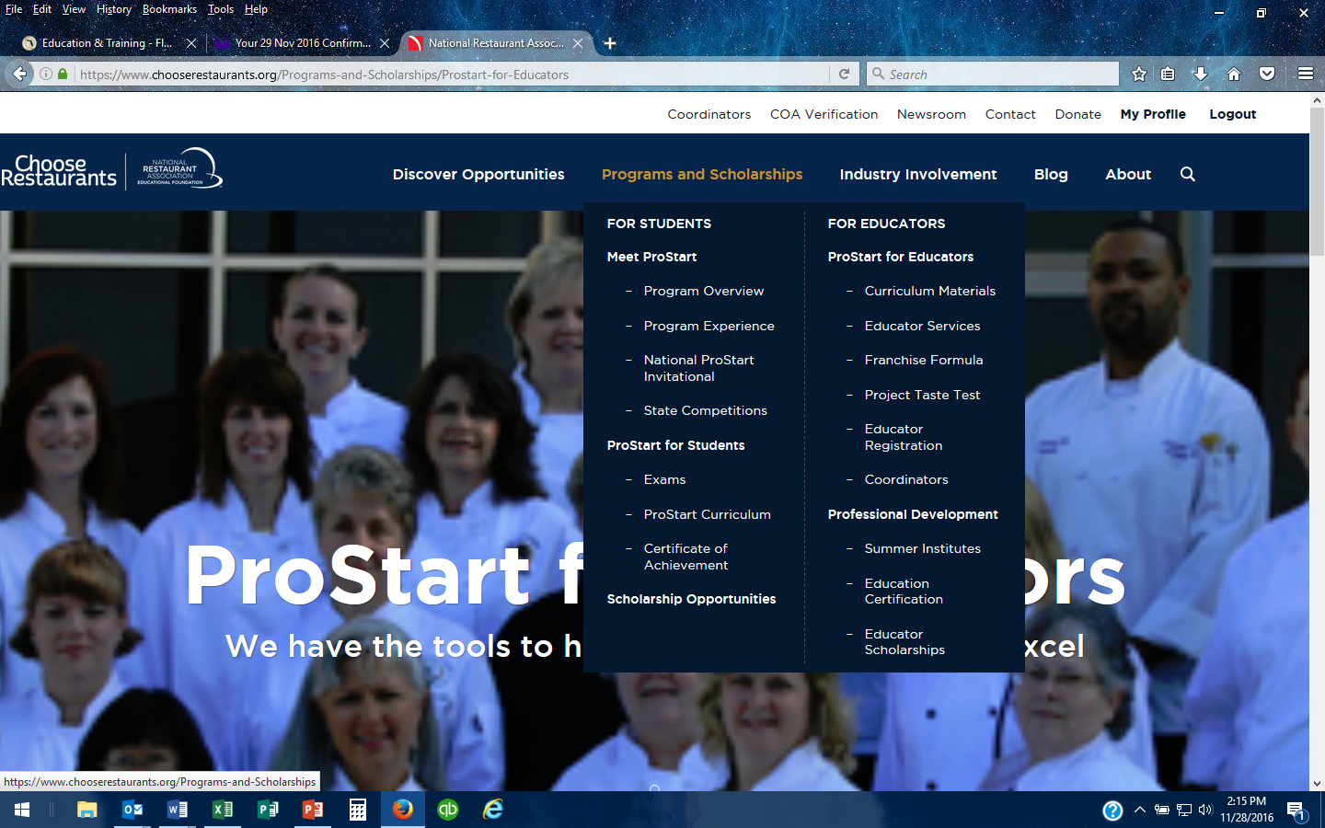
Notes:
Look under the Programs and Scholarships tab to find general information, copies of forms and FAQs
Please Note: The new system considers passing the first exam as the application for a COA. “Track COA Progress” will only show up once a student has passed his/her initial exam. Remember: the FRMCA text books are not sequential. Students may take Level 2 before taking Level 1.
If nothing shows up when a student clicks “Track COA Progress” it is likely that :
The student has not registered
The student has not signed in
The student has not passed the initial exam
More than three years has passed since the student took the initial exam. Exam scores are valid for 3 years (that has not changed) so
a COA Application is valid for 3 years from the date of the initial examination
FRMCA

Slide 6
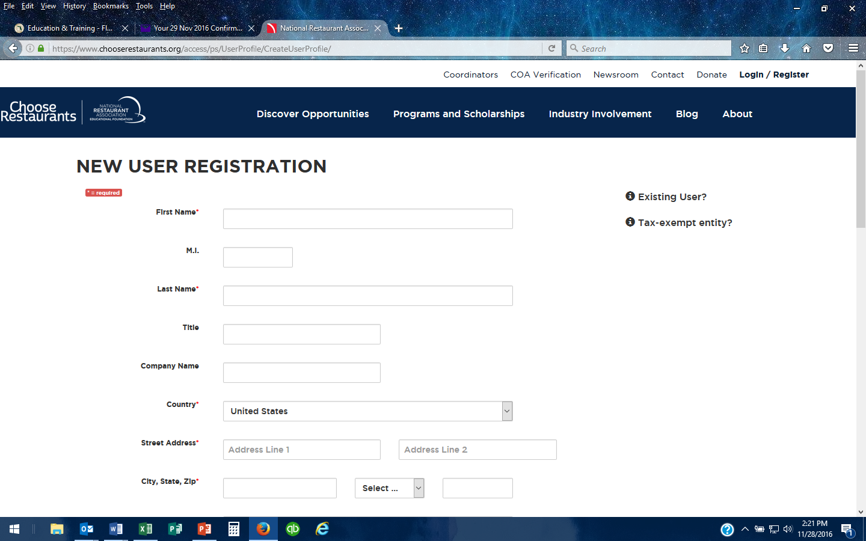
Notes:
Students must register on the website.
We recommend all students register in the first few weeks of class. It is not recommended that students begin the registration process on the day of their first exam!
Best Practice: Advise students to use their “legal name”—the one on their driver’s license or id—when creating a profile. The most frequent reason delay in processing a COA application
occurs when students have used different names on exams. If the score for the Level 1 exam is recorded for James Smith and the score for the Level 2 exam is recorded for Jim Smith,
the system treats the individual as two separate people with two un-linked records.
Best Practice: Have each student put his/her login information on an index card and give it to the teacher so a reminder is available for those who might forget their login on testing day.

Slide 7
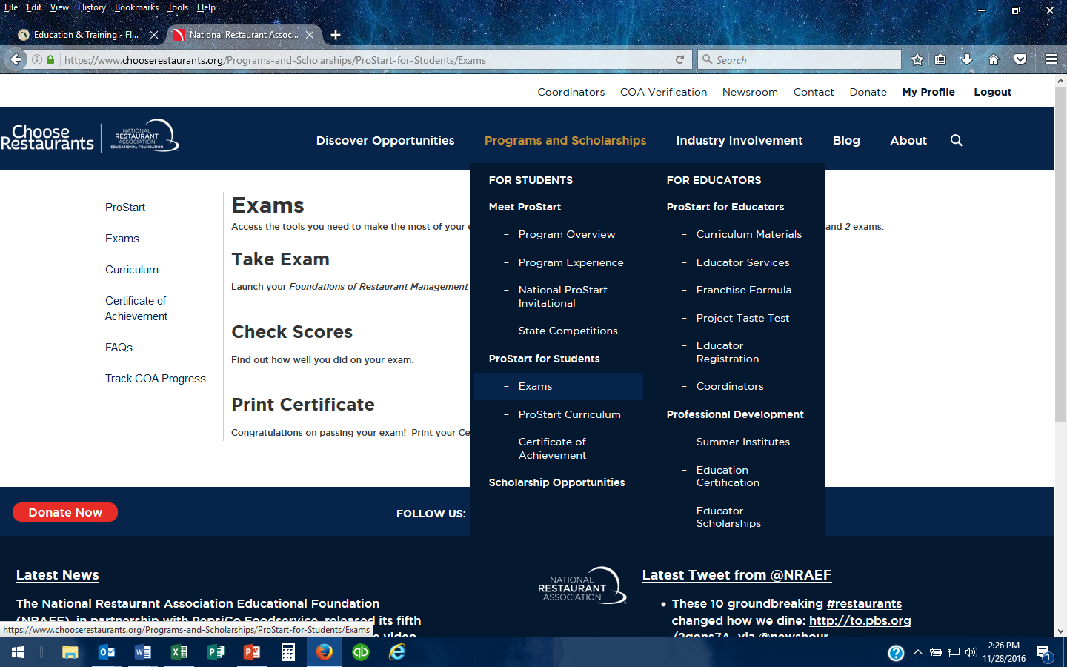
Notes:
After students have registered, they may check exam scores and track their COA progress if they wish.

Slide 8
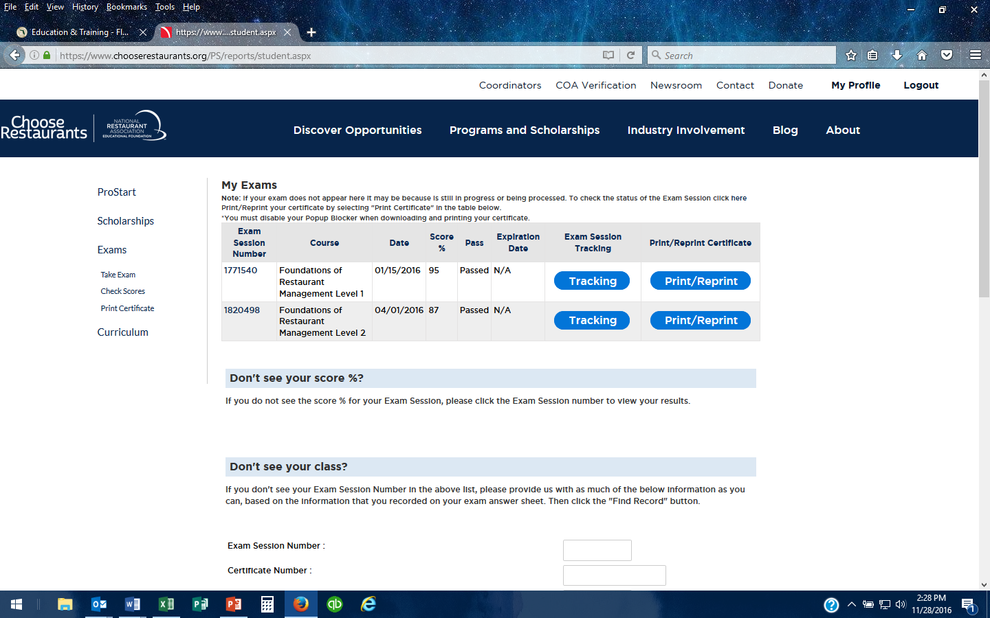
Notes:
When the student clicks on Check Scores, this page will appear. This student has taken and passed both FRMCA exams. The student may print a certificate
for their exams if they wish.

Slide 9
Notes:
Students can track their COA progress by clicking here.

Slide 10
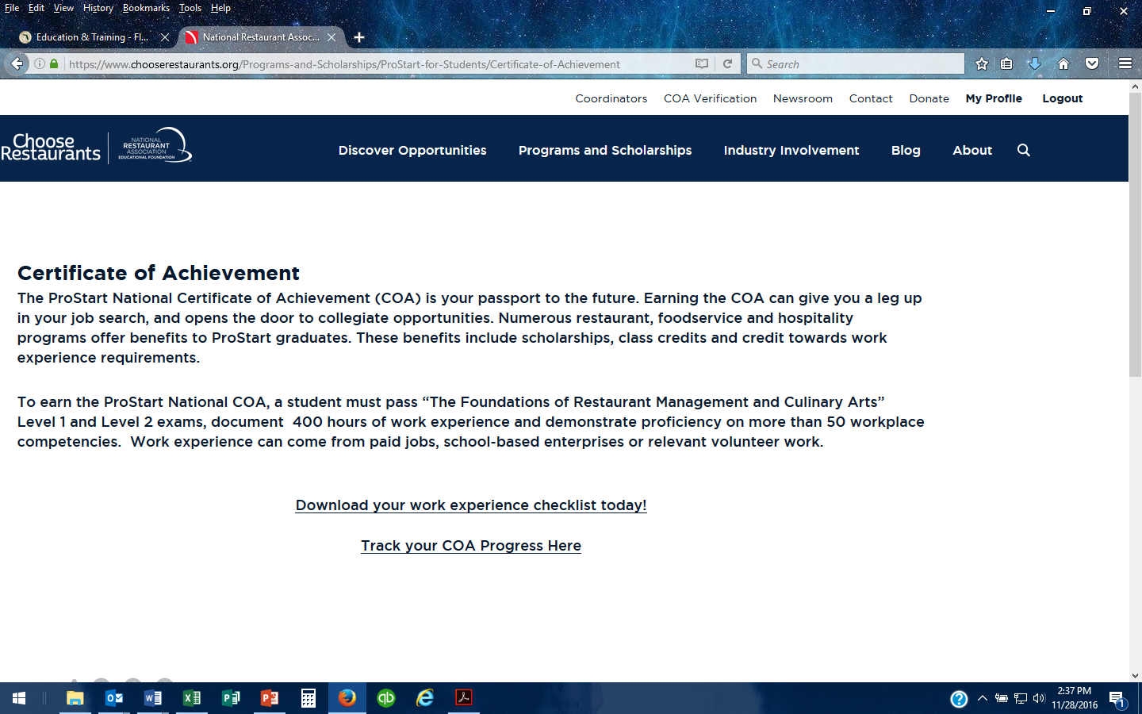
Notes:
One of the COA requirements is for the student’s employer to check off certain work competencies. Students must complete 52 of the 75 competencies.
The Checklist can be downloaded here. You can also contact us to email you a copy.

Slide 11
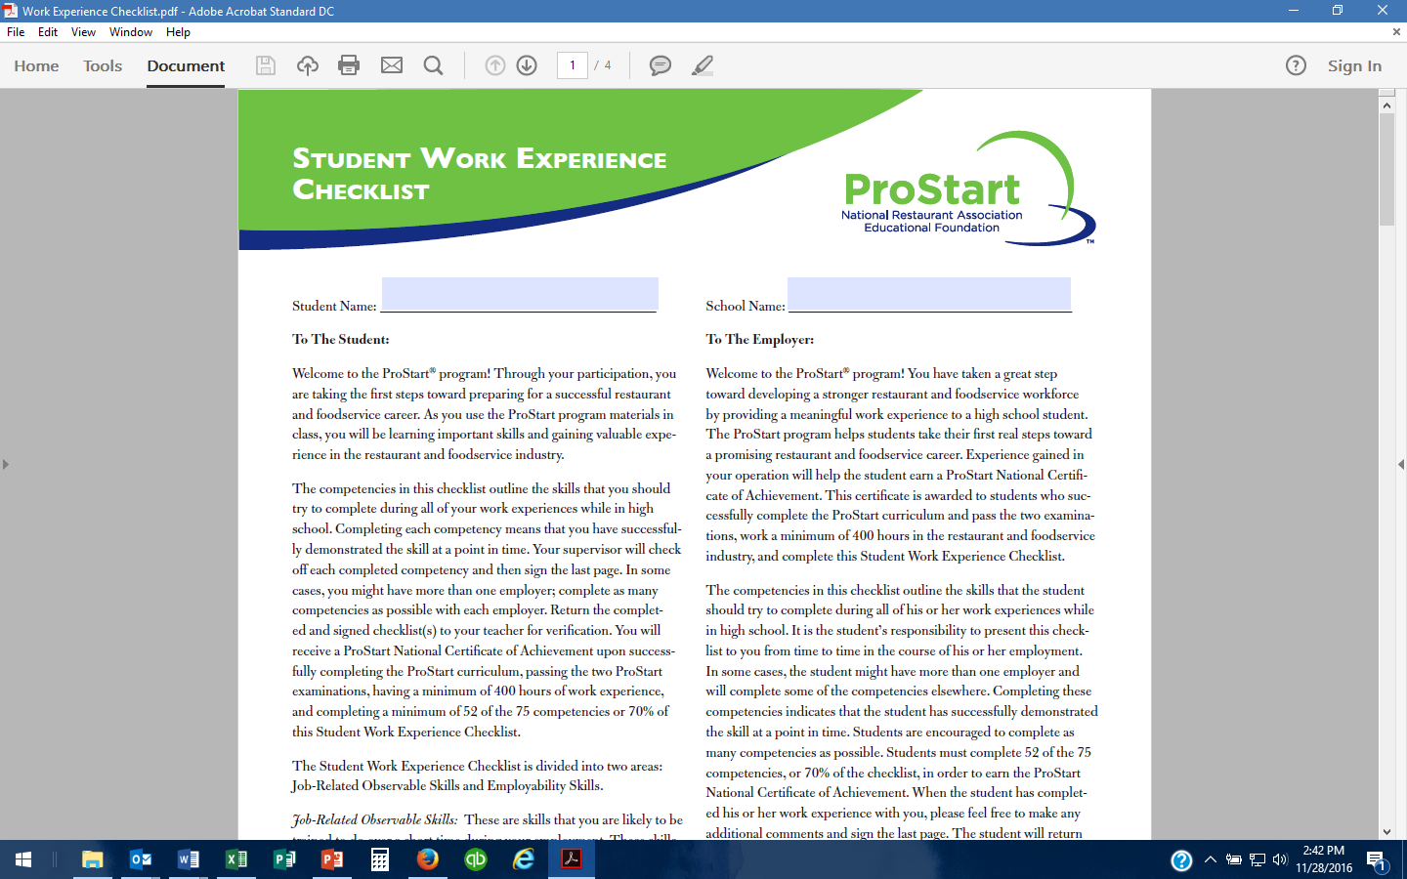
Notes:
One of the COA requirements is for the student’s employer to check off certain work competencies. Students must complete 52 of the 75 competencies.
The Checklist can be downloaded here. You can also contact us to email you a copy.

Slide 12
Notes:
Students can track their COA progress here.

Slide 13
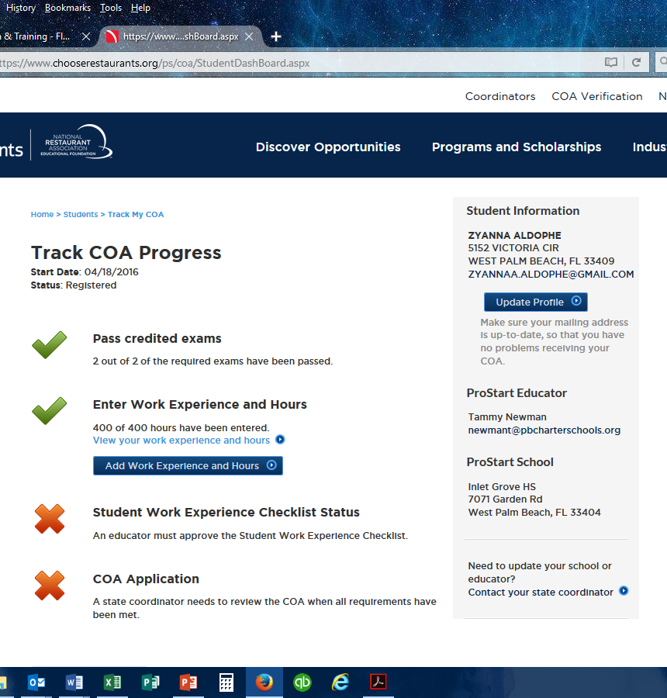
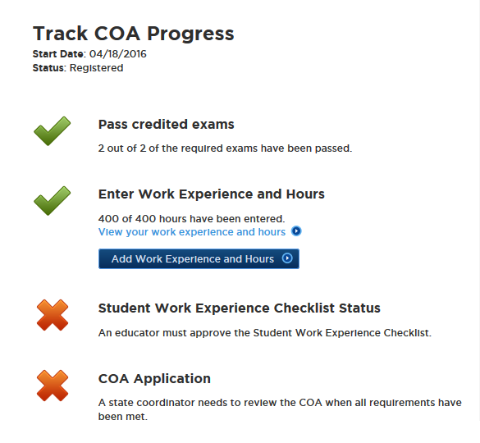
Notes:
WHAT A STUDENT WILL SEE:
This student has passed both exams and has entered all required work experience hours
Student records are connected to the educator who administered their most recent exam
Please Note: To change school or educator, students should contact their state ProStart Coordinator.

Slide 14
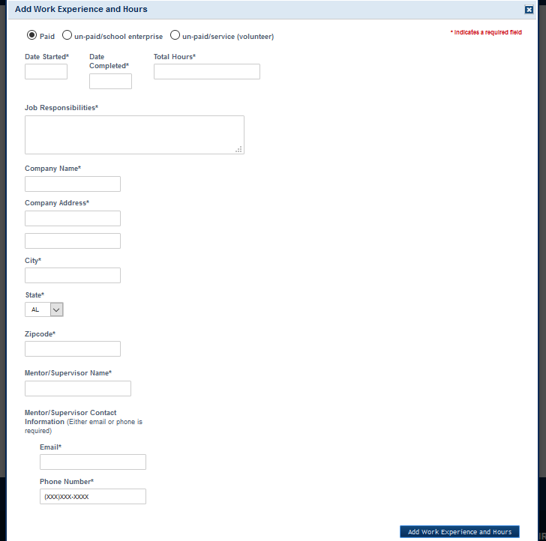
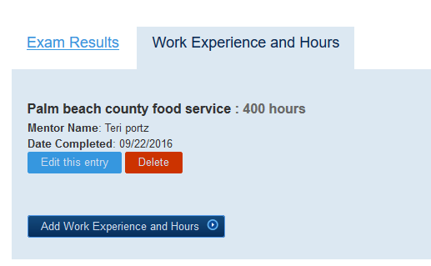
Work Experience Hours
Notes:
When a student is entering required work experience hours:
There is no limit to the number of jobs a student may enter. Hypothetically, 400 jobs of one hour each could be entered.
“Jobs” may be paid, unpaid/school enterprise or unpaid service/volunteer work.
THERE MUST BE a start and stop date for the work experience:
This does not mean the student must stop working at the job, it just means he/she stops recording hours for ProStart.
A brief description of job responsibilities is required. For instance: “general back of the house,” “”Garde Manger,” “dishwasher,” “front of the house general duties,” “assisted chef at benefit dinner,” etc.
A company name and address are required: for school enterprise, the “company” would be the school/program catering program or school restaurant etc. For service, the company would be the organization.
Students MUST enter either an email address or phone number for the mentor or supervisor.

Slide 15
Notes:
EDUCATORS:
Educators must register to manage COA applications and access exams
After the educator creates a profile, in order for access as a ProStart Educator to be granted, the state ProStart Coordinator must approve the educator registration. It can take 2-3 days after creation of a profile for access to be granted.
Best Practice: ProStart educators should create a profile early in the school year and should take some time to become familiar with the website—both the public spaces and those available only to ProStart educators.
A requirement of Full ProStart Programs is they are registered as a ProStart Educator

Slide 16
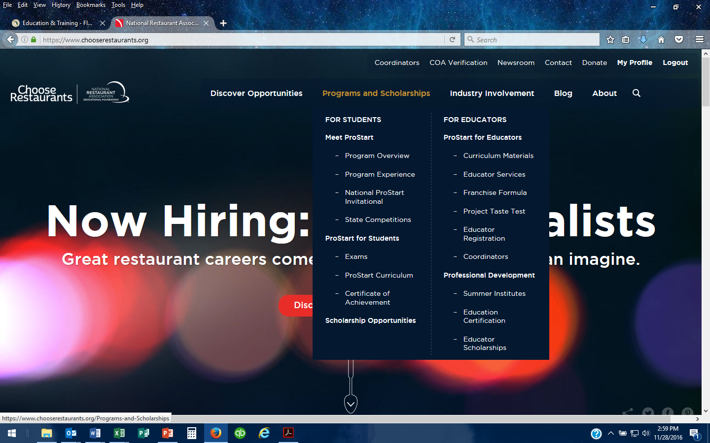
Notes:
Once registration has been confirmed, the teacher can login to the website. Under the Programs and Scholarships tab, click on Educator Services to access to the COA information.

Slide 17
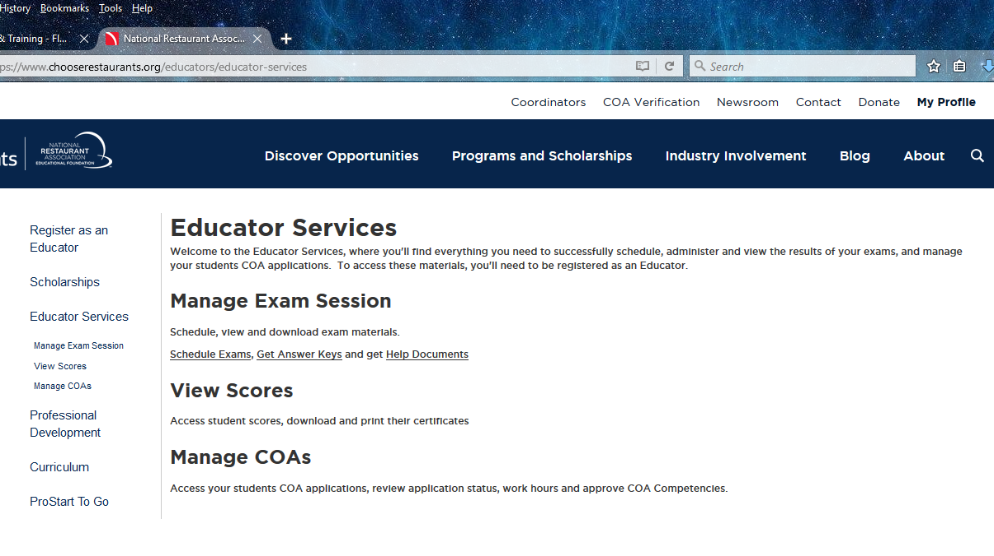
Notes:
PLEASE NOTE the new section under Educator Services: “Manage COAs”
Best Practice: “Help Documents” under “Manage Exam Session” are VERY helpful. Become familiar with them prior to exam day.

Slide 18
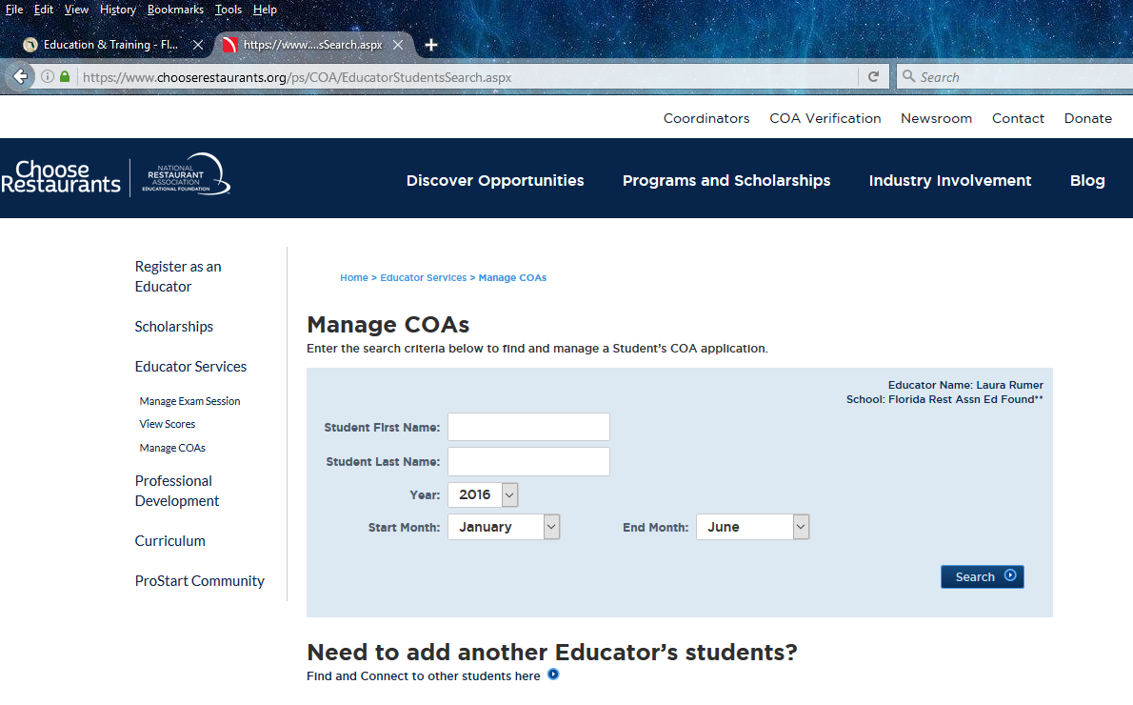
Notes:
Educators can search for any student at the school to see the status of a student’s COA application.
Remember: COA applications are connected to the educator who administered the student’s most recent exam. That means the record for a student
who took Level One—and that exam—from Teacher John Doe and is now enrolled in Level 2 with Teacher Mary Jones will be attached to Teacher John Doe. Once this student
takes the Level Two exam from Mary Jones, the student’s records will be attached to her.
You can change the year, start and end months. FYI the End Month defaults to June . . .

Slide 19
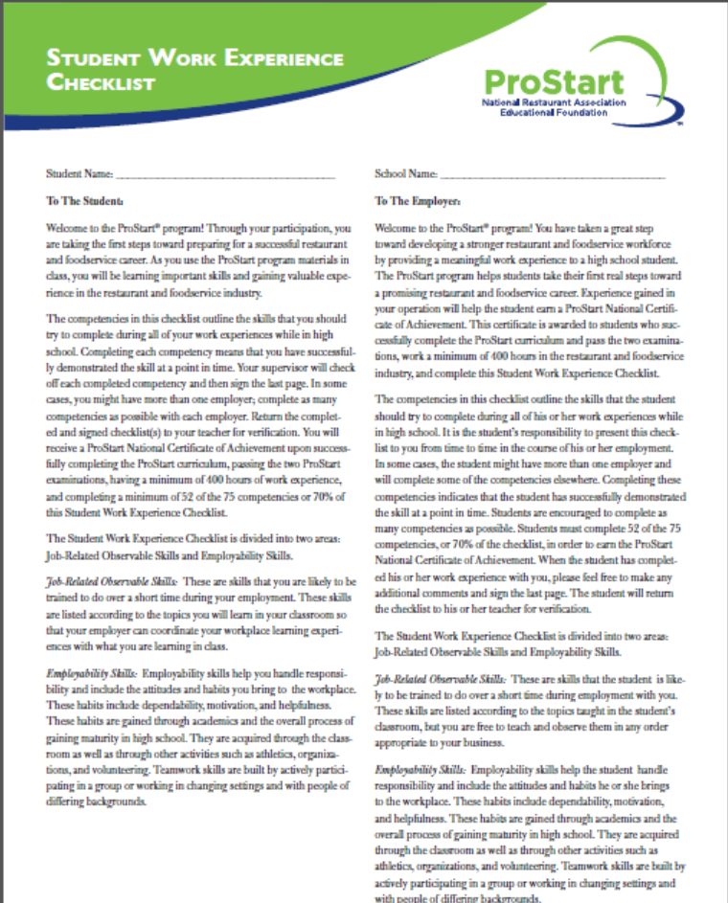
Workplace Checklist
Notes:
Note: in addition to documenting 400 hours of experience through the new online system students must still submit signed work experience checklist(s) to the teacher for approval
Must have “sign off” on a total of 52 of the 75 Competencies. The Checklist has space for 3 supervisors to sign; but a student may submit multiple checklists, each signed by only one supervisor/mentor.
Remember: class “labs” and practice for competition do not count for competencies or for work experience hours.
None of this has changed.

Slide 20

SCAN & EMAIL
aparker@FRLA.org
laura@FRLA.org
MAIL
FRLAEF
PO Box 1779
Tallahassee, FL 32302
UPS/FEDEX
FRLAEF
ATTN: Amy Parker
230 S Adams St
Tallahassee, FL 32301
Notes:
Teachers must examine and confirm work experience documentation (pay stubs, letters from supervisor, signed forms etc.)
Teachers must also examine the signed Work Experience Checklist to confirm that 52/75 competencies have been reached.
Teachers should send all of the documentation for each student to the FRLAEF:
Proof of at least 400 foodservice industry work hours (check stub or letter/memo/email from employer stating hours worked)
Completed Work Experience Checklist (should be signed by mentor)
If documentation for hours is missing or the competencies achieved don’t total 52, the COA application will be considered Pending.

Slide 21
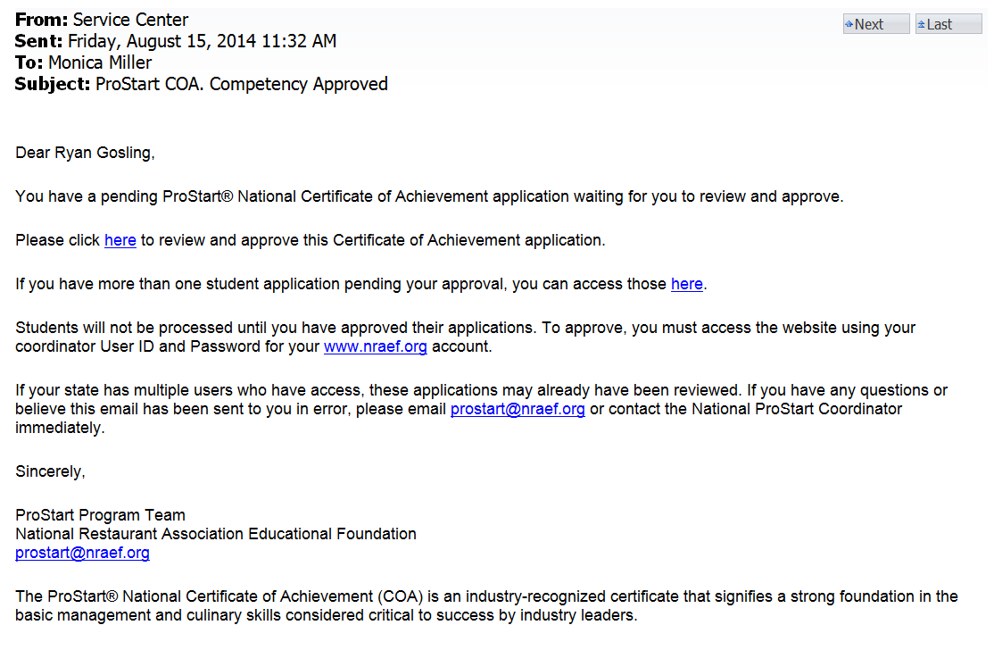
Notes:
The State ProStart Coordinator will be notified whenever an educator has approved a COA application. A sample of the Coordinator email is shown here.
After reviewing and confirming the documentation, the state ProStart Coordinator may approve a student’s COA application
Once the Coordinator approves an application, the COA will be awarded and mailed directly to the student using the address that student has in his/her profile
Students will receive a reminder to check the address in their profile before the COA is mailed

Slide 22
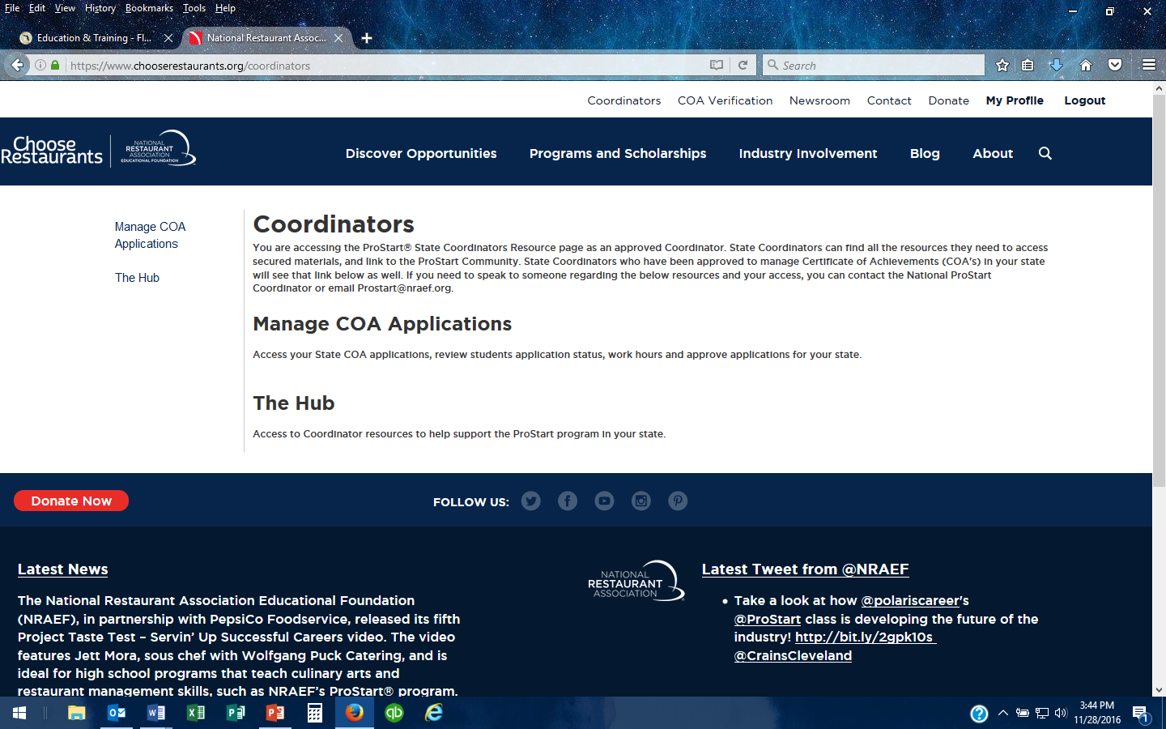
Notes:
State Coordinators also have the ability to check on the status of COAs.

Slide 23
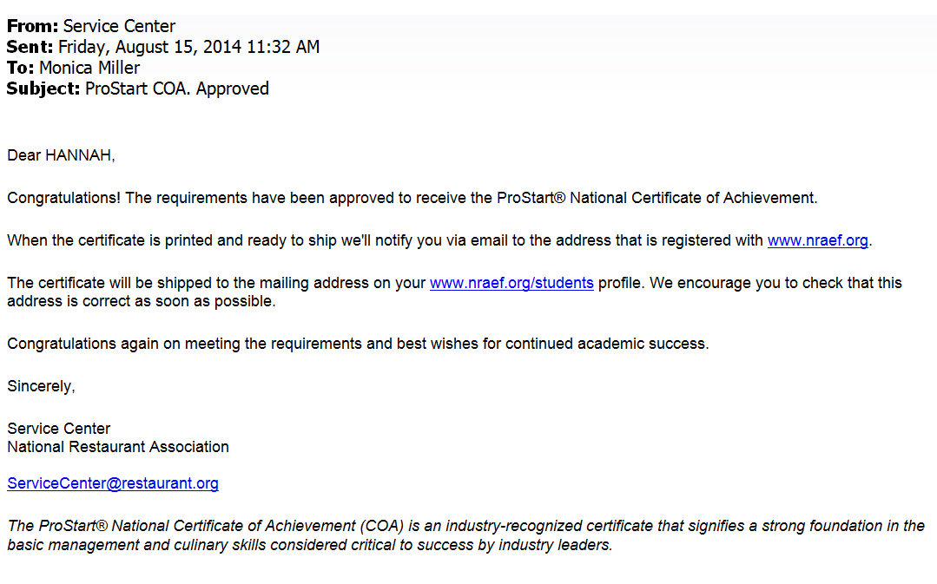
Notes:
A second email is sent to the student when a COA is ready to be shipped

Slide 24
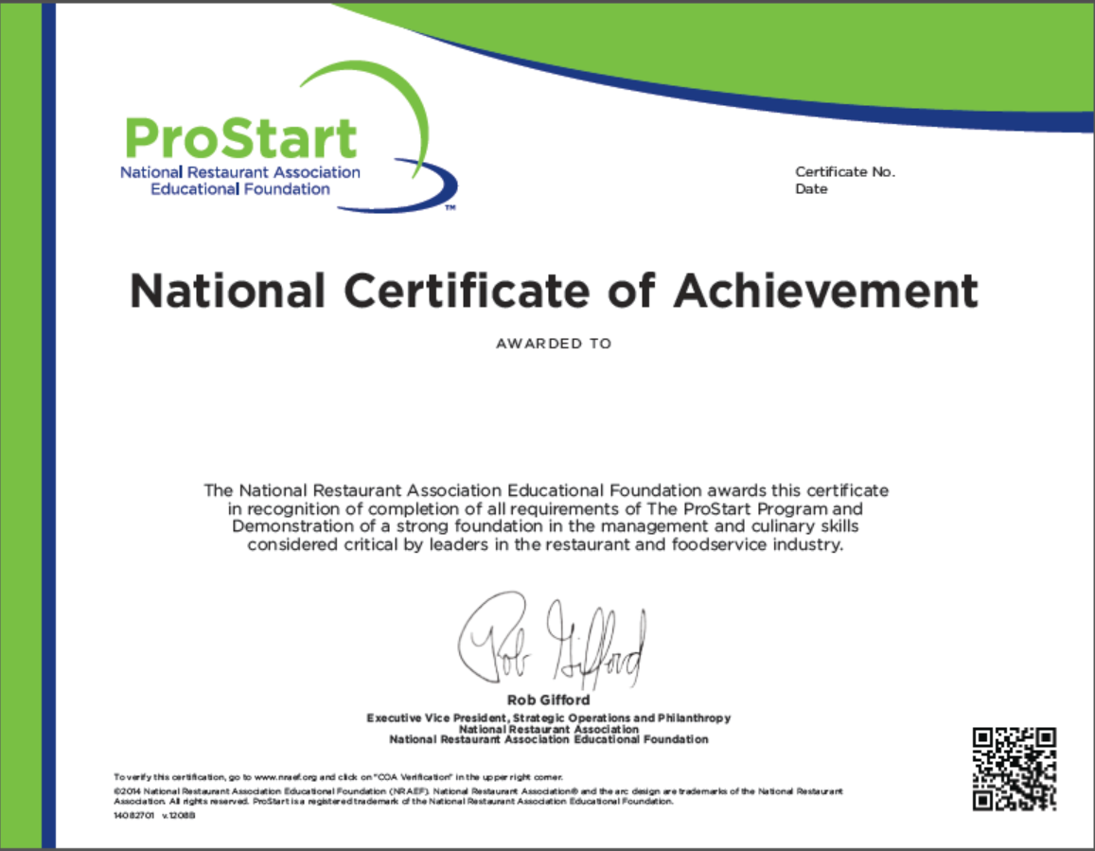
NEED NEW FRONT AND BACK
Notes:
The new Certificate has a QR code, which can be scanned to verify authenticity. It also contains information on how to verify authenticity online.
Note that verification is available only for COAs issued under the new, online process which went into effect September 12, 2014.

Slide 25
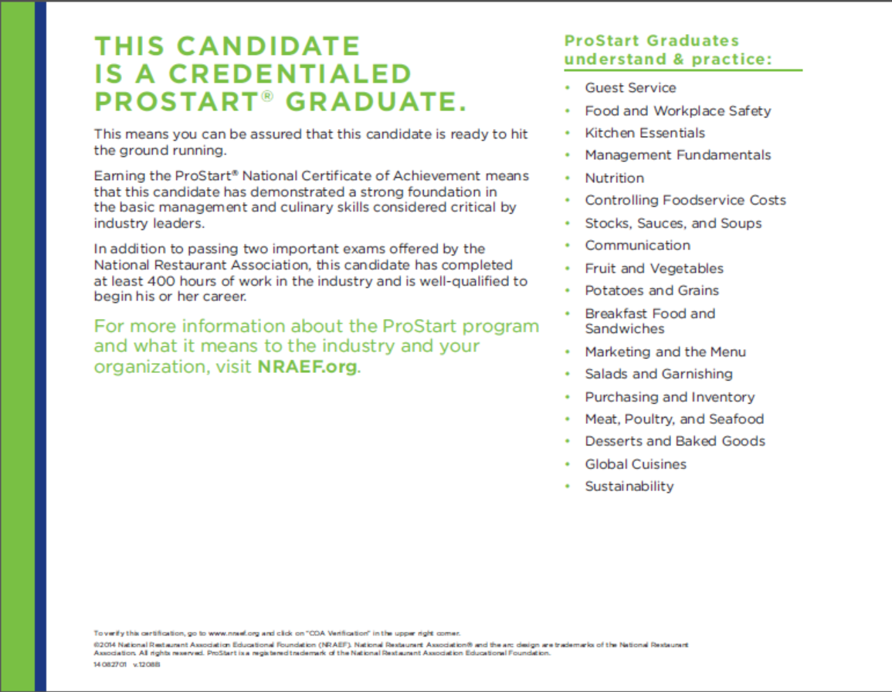
Notes:
The back of the new COA includes information for prospective employers and post-secondary institutions on what it means.

Slide 26

REJECTED
Notes:
If after examining the documentation for a student’s COA application, the state ProStart Coordinator rejects the application the educator will be notified.
The educator should contact the coordinator to learn why the application was rejected and what needs to happen for the Coordinator to approve it.

Slide 27

Notes:
The State Restaurant Association office must maintain all student documents related to COA applications for a minimum of 5 years.
NRAEF must conduct yearly audits of COA documentation.
Programs that are found in flagrant/repeated violation of documentation requirements may have the authority to approve COAs revoked.

Slide 28
Q&A
Notes:
Q&A…
Watch the NRAEF website for FAQs
Best Practice: become familiar with www.nraef.org
If teachers have a problem using the new process or have a question about it, the state ProStart Coordinator should be contacted. NRAEF will respond to questions only after the state Coordinator has been notified and has
requested assistance from NRAEF.

Slide 29
@ProStart
/ProStartProgram
/ProStartProgram
NRAEF.org/ProStart
/GoProStart
Notes:
Thank you!

